Slide 1

A Glance at Marriage Longevity
Alex Yee

Slide 2
Dataset logistics – is this reliable data?
Data taken from 33 countries – 7178 participants
My final dataset took countries with at least 99 participants – 5 countries excluded
Minimum number of samples for statistical significance is 30
Any entries containing NaN values were excluded
Checked for egregious outliers (improperly recorded values) – none found
Each country had their own local research team
All participants were married took the survey voluntarily – no compensation was provided, except for Hong Kong
Participants consisted generally of students and adults in the work environment
Procedure among participants was identical – Pen/Paper 30 minute survey
Source: https://www.ncbi.nlm.nih.gov/pmc/articles/PMC5519603/

Slide 3
The Machine Learning Process
What are we predicting?
Marriage Duration
X Values: Country, Sex, Age, Number of Children, Education Level, Material Satisfaction, Religion, Religiosity, Agree with Prenup?, Marriage Satisfaction Level
What tools do we need to make our analysis possible?
Python – Matplotlib, Pandas, Sklearn, Tensorflow
Tableau
We want to create a regression analysis by applying supervised learning
Identify categorical data and reorganize data columns
Split our data into training and testing data
Fit our data
Run algorithm

Slide 4
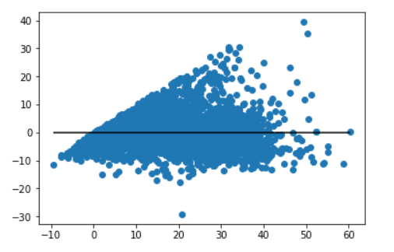
Residuals: (Observed - Predicted) R2 Score: 0.8195212105023134

Slide 5
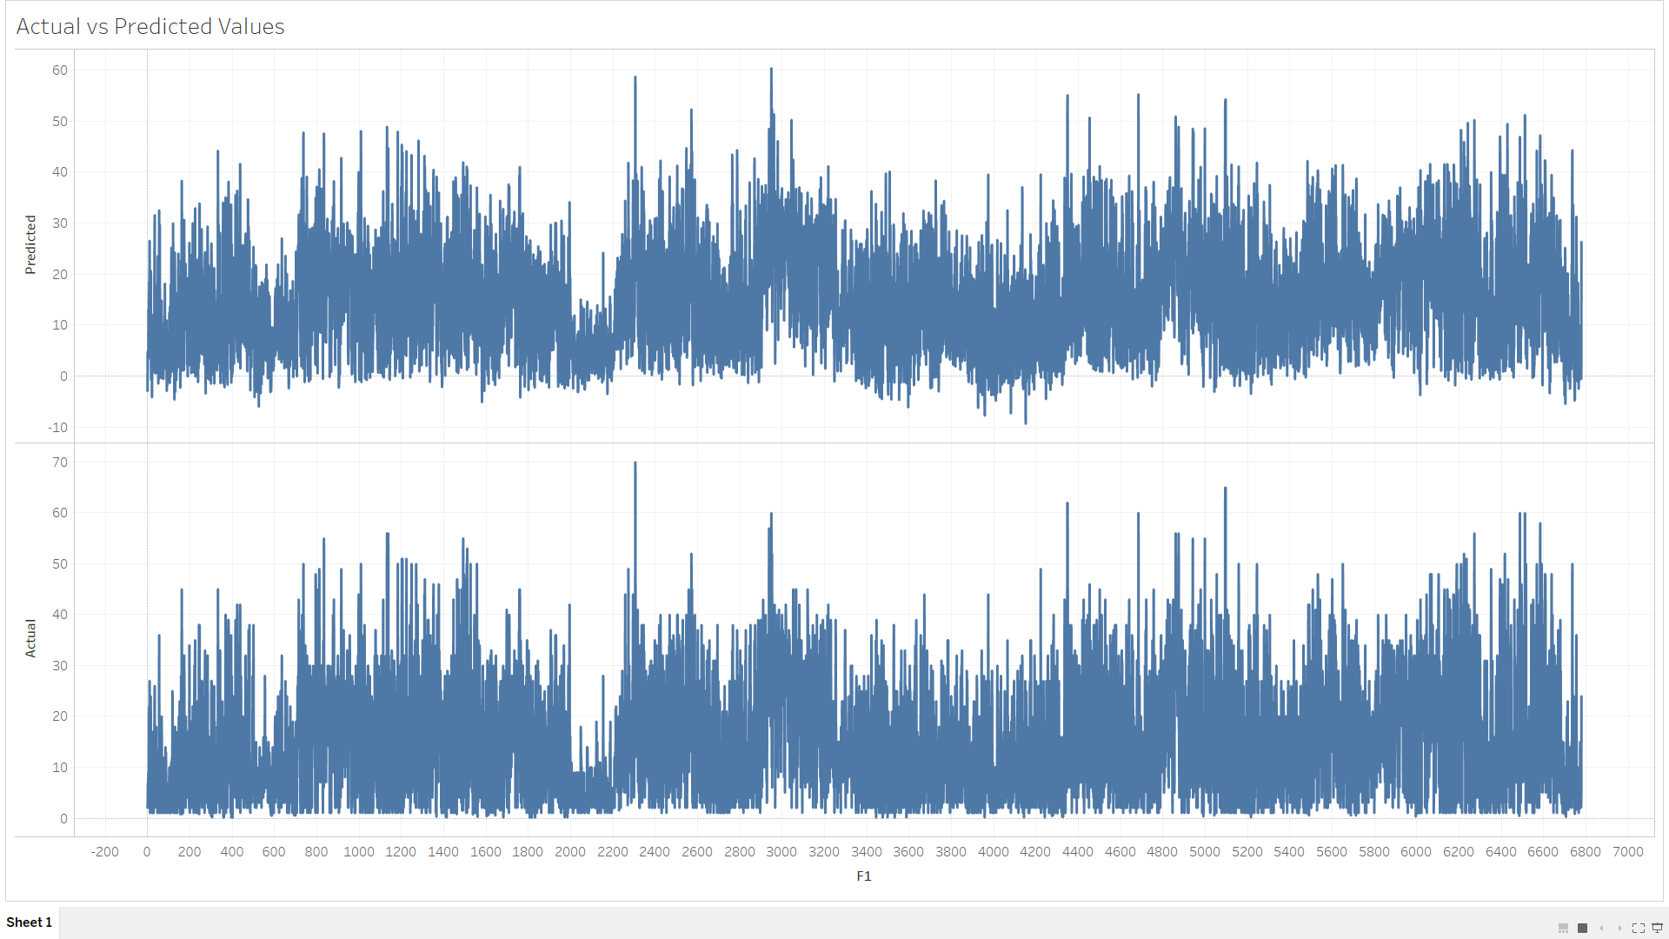

Slide 6
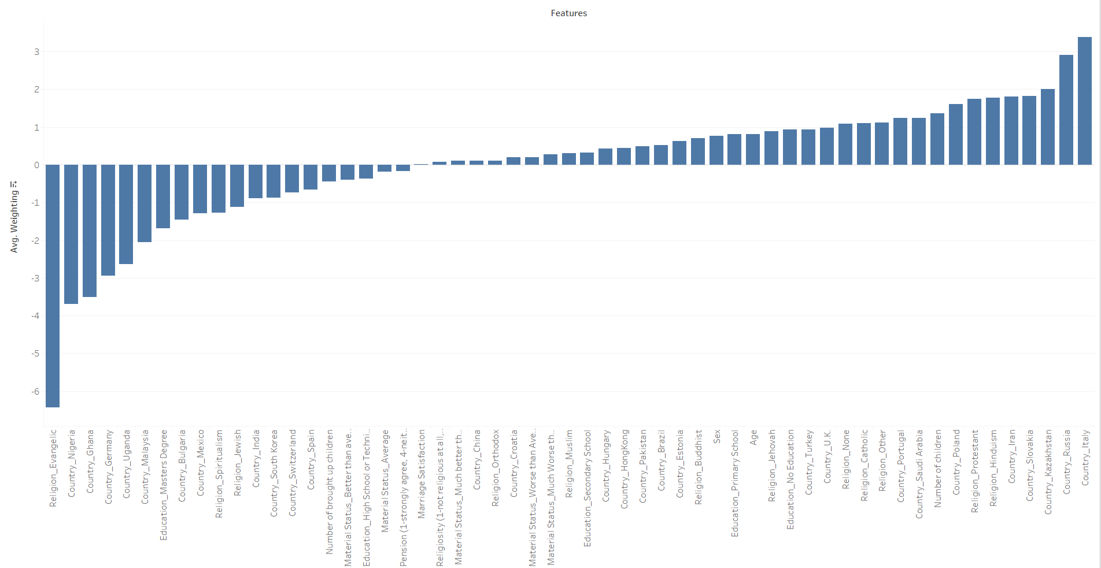
4 most positive contributing factors to marriage longevity:
Religion: Protestant
Number of Children
Religion: Hinduism
Education: No Education
Religion: Jehovah
4 most negative contributing factors to marriage longevity:
Religion: Evangelic
Education: Master’s Degree
Religion: Spiritualism
Religion: Jewish
Number of Brought up Children

Slide 7
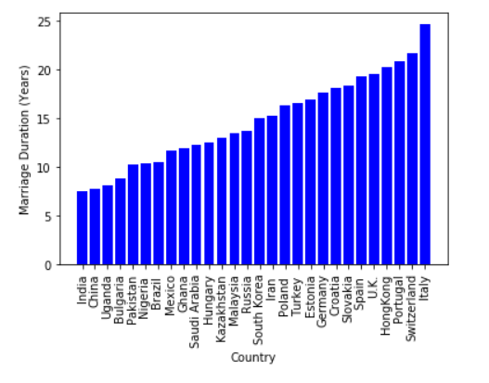
Top 5 Countries:
Italy
Switzerland
Portugal
Hong Kong
Spain
Bottom 5 Countries:
India
China
Uganda
Bulgaria
Pakistan

Slide 8
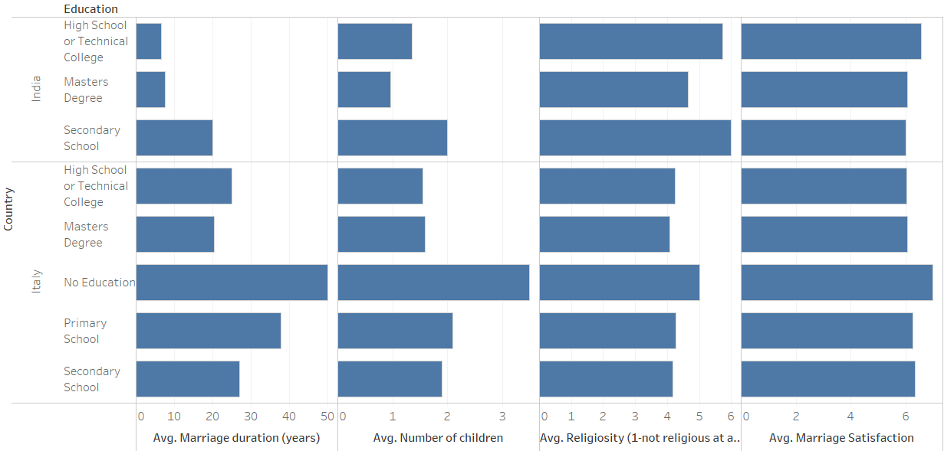
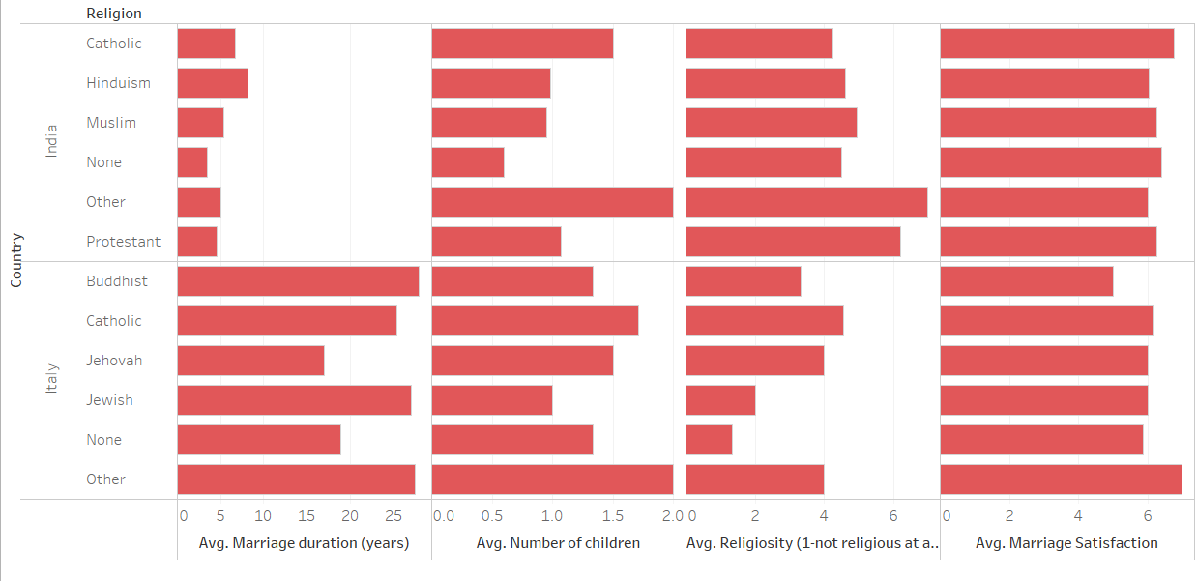
An in-depth look at the countries with the shortest and longest marriage longevity

Slide 9
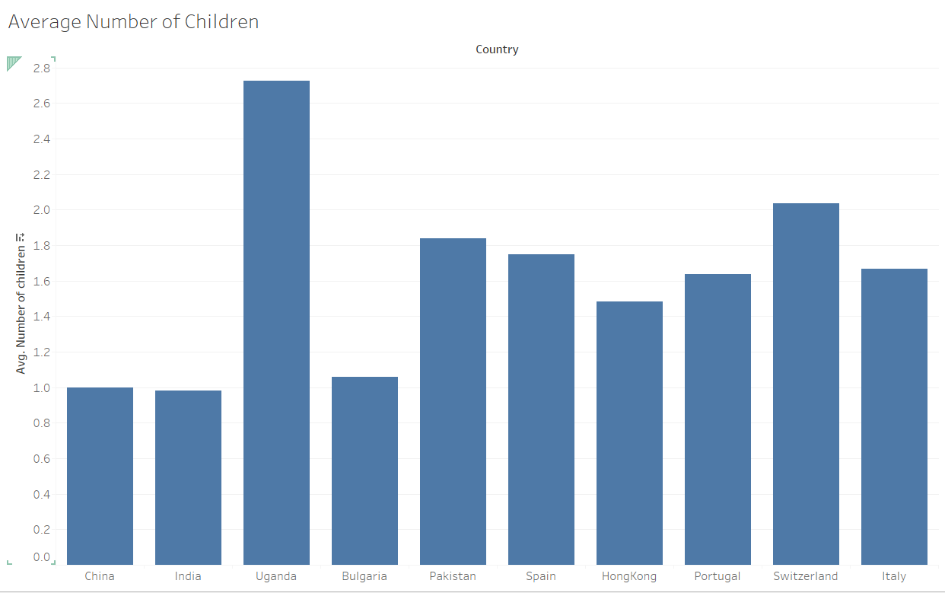
Country-by-Country Analysis

Slide 10
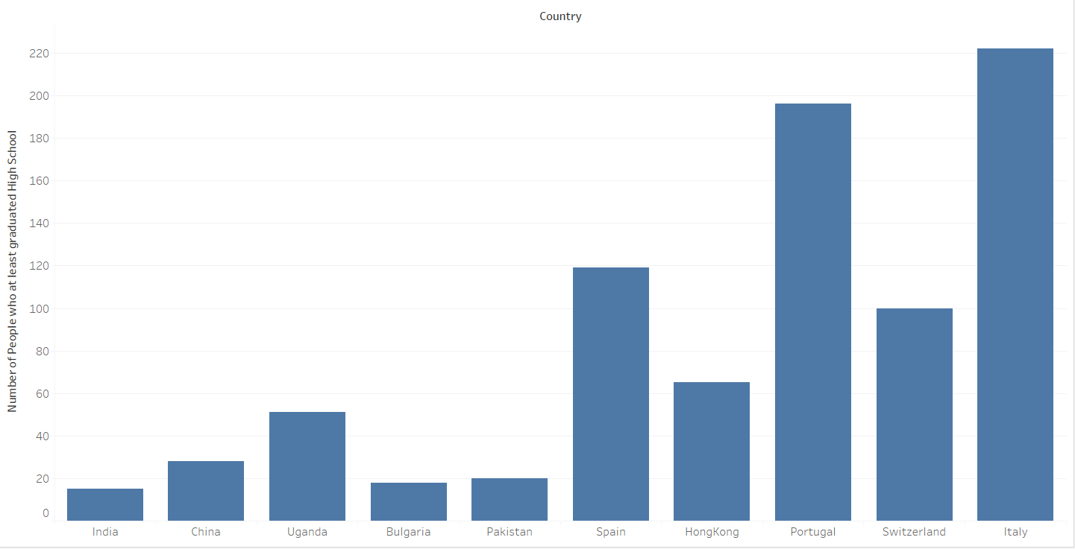
Country-by-Country Analysis

Slide 11
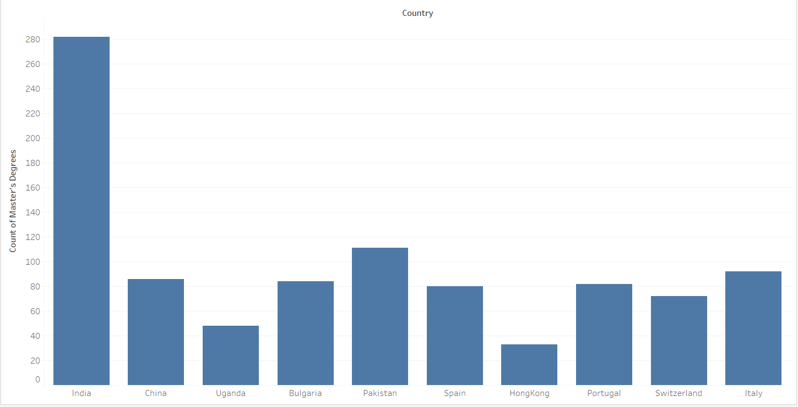
Country-by-Country Analysis

Slide 12
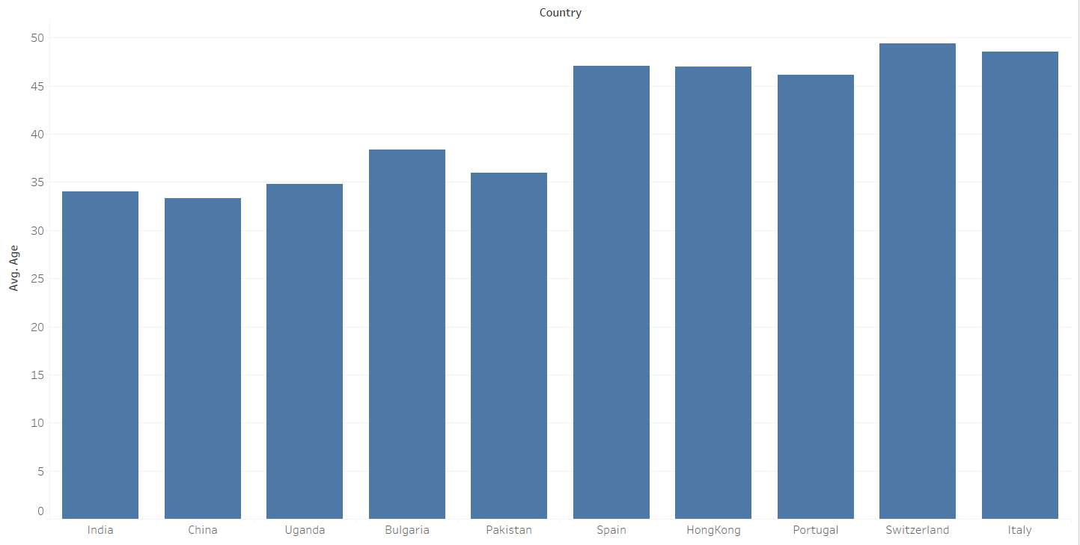
Country-by-Country Analysis

Slide 13
Conclusions/Limitations
The only conclusion we can definitively make is that there is a relationship between the country of origin and marriage longevity
All participants were married so participants who were older naturally had longer marriages

